Slide 1

Flight Fare Data Analysis
Arnab Samanta
22-07-2024

Slide 2

OUTLINE
Introduction
Methodology
Results
Visualization-charts
Findings
Conclusion

Slide 3

Introduction
About: Flight Fare Data Analysis
Objective:
Factors that impact flight ticket price
Check if specific city pairs with consistently high or low prices
Check is there any optimal time for ticket booking.

Slide 4

Methodology
Data Collection
Link: https://drive.google.com/file/d/1n9FqH3D1-nvviwvktEZeW4cgEPacGuRe/view?usp=drive_link
Data Pre-processing
Data Profiling
Data Cleaning
Data Consistency
Data Formatting
Outlier Detection & Removal
Exploratory Data Analysis

Slide 5
Results
Visualization (charts)
Distribution of flight price - page 6
Number of flights and average flight price per airline - page 7
Average flight duration per airline- page 8
Number of flights and flight price per class - page 9
Number of stops per flight and average flight price per number of stops - page 10
Price change with change in source to destination - page 11
Departure time, arrival time v/s flight price - page 12
Days left for departure v/s flight price- page13
Flight duration v/s price- page14

Slide 6
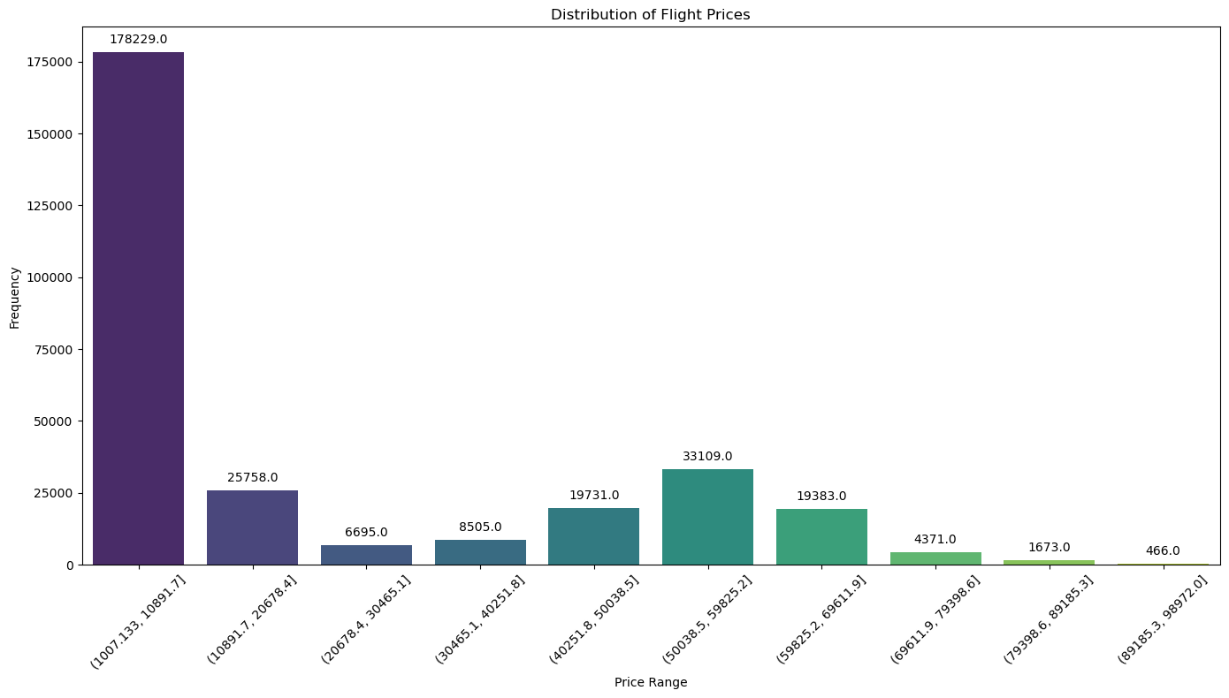
The distribution of flight prices indicating that most flights are priced lower, there are a few flights with significantly higher prices.

Slide 7
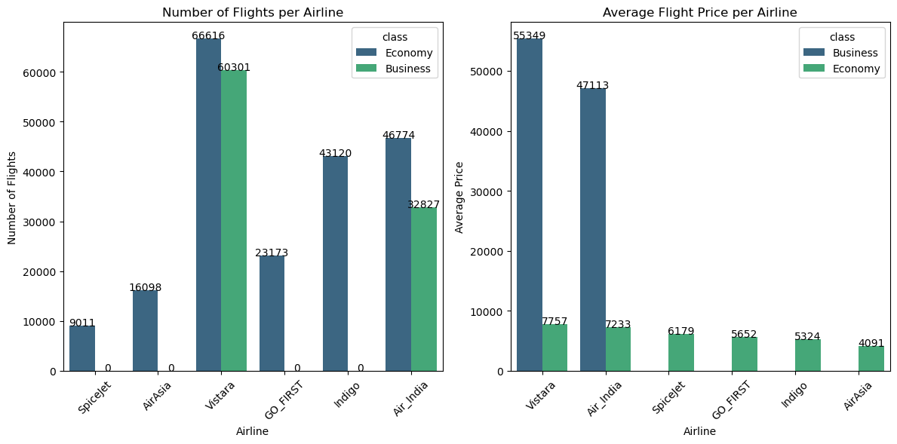
Vistara has the highest number of flights in economy class making it the most frequent airline in the dataset. Vistara and Air India have the highest average flight prices on business class suggesting a focus on premium pricing strategies. Economy class flights are cheaper compare to business class.

Slide 8
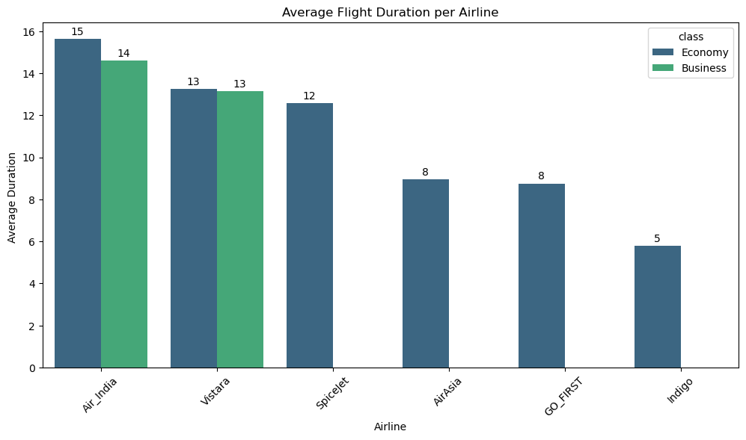
Some airlines have significantly longer flights on economy class while others are much shorter (e.g., GO-FIRST with 8 and Indigo with 5 unit of time).

Slide 9
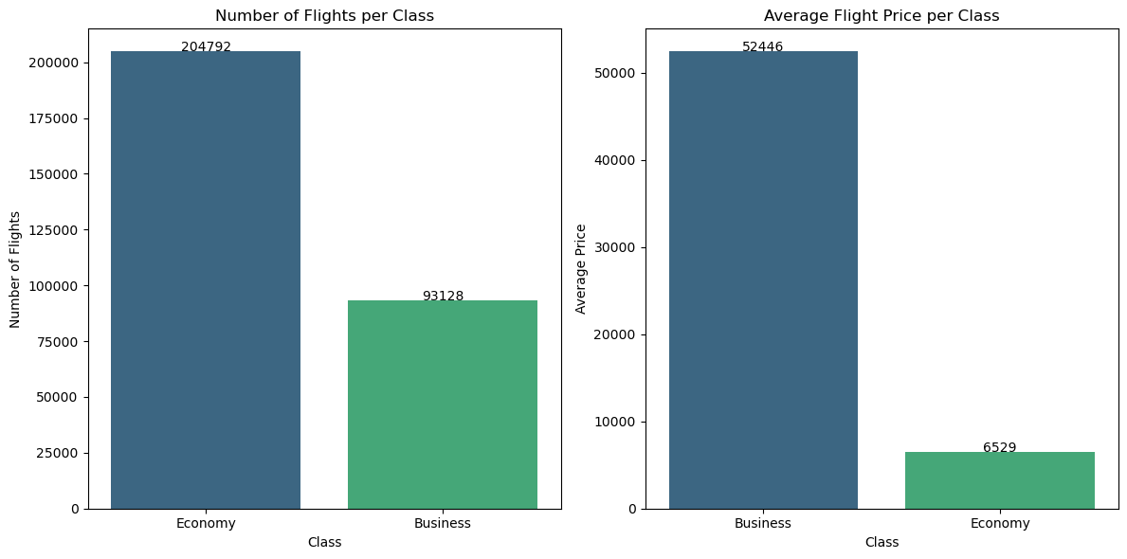
Economy class has a significantly higher number of flights (204,792) compared to Business class (93,128).But Business class has a higher average price (52,446) than Economy class (6529).

Slide 10
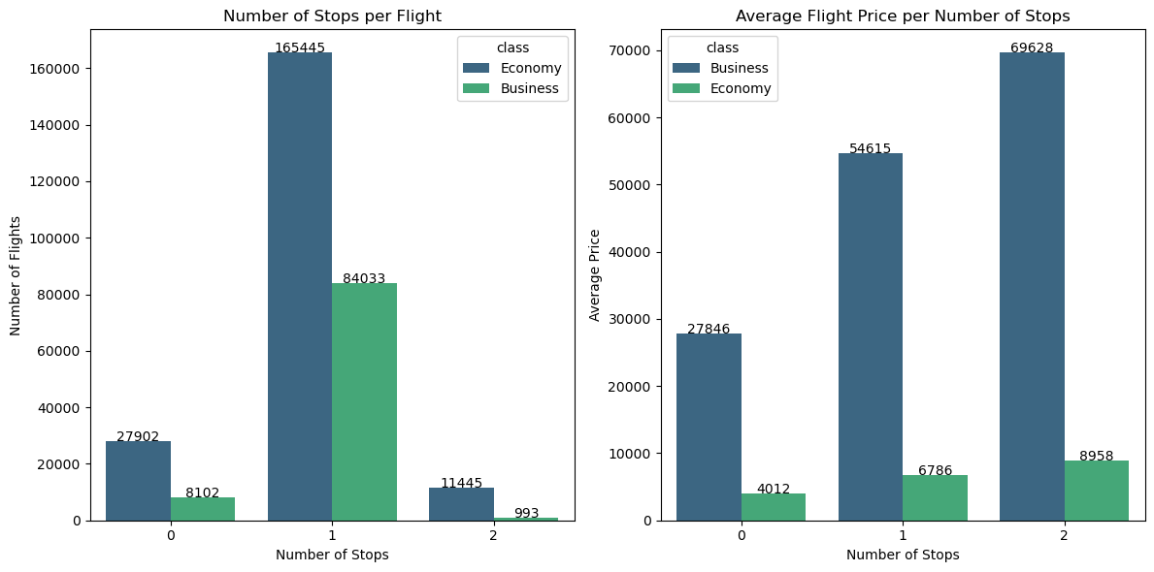
Most flights in economy have either 1 stop or no stops . A smaller number of flights have 2 stops. Flights with 2 stop tend to be the most expensive .Flights with 1 stops are cheaper than 2 stop flights but still pricier than direct flights in business class. Economy class 0 stop flights are cheaper compared to other.

Slide 11
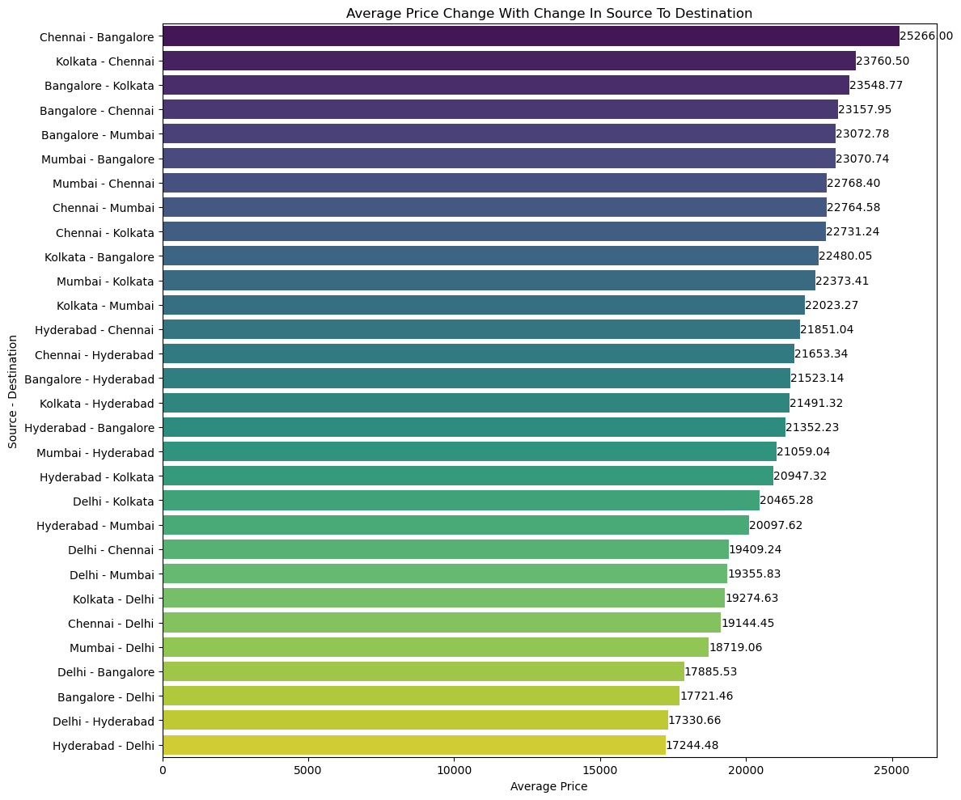
Chennai to Bangalore flights are most expensive flights compare to other source city to destination city flights

Slide 12
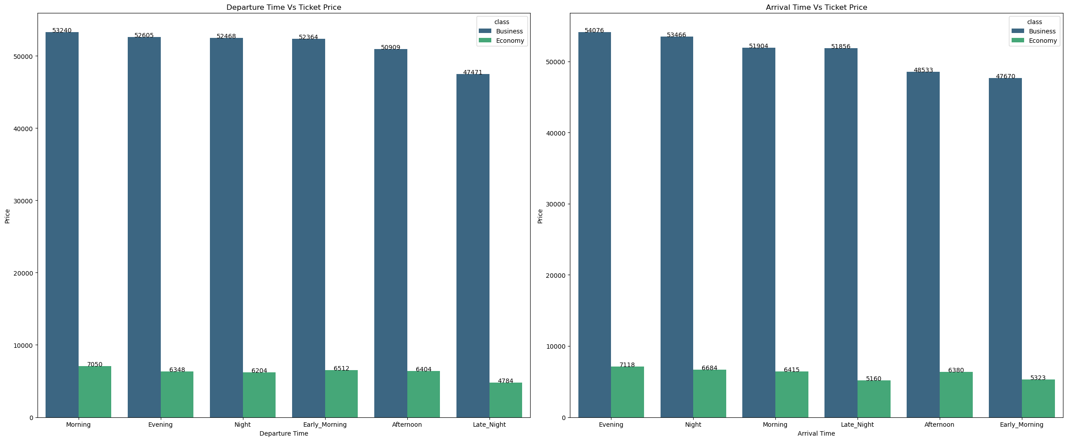
The graph comparing departure times with total prices shows that morning flights tend to be the most expensive, followed by evening , night, early morning flights in business class. Afternoon and late night flights have a lower price in business class. The graph comparing arrival times with total prices reveals evening flights are associated with higher prices, followed by night arrivals Early morning arrivals are the least expensive in business class. Economy class flights of late night arrival are cheap.

Slide 13
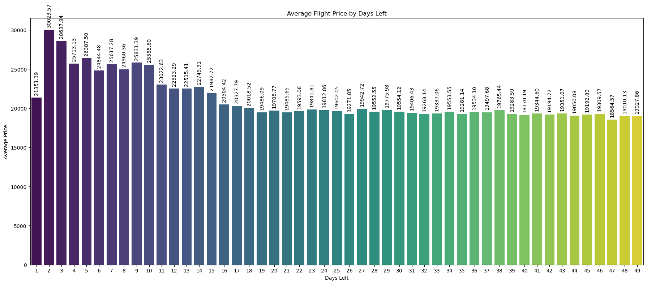
When there are many days left before departure, prices are low in that time. However, prices are increases as the departure date gets very close

Slide 14
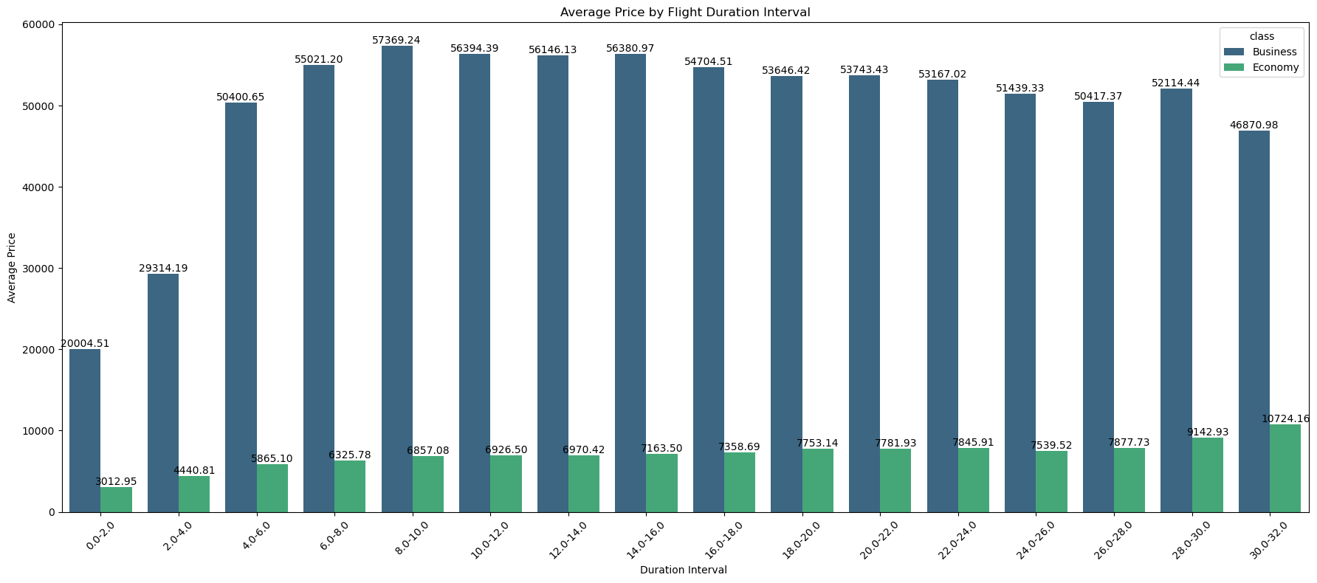
Ticket prices tend to be lower for shorter economy class flights. For budget-conscious travelers, Economy class remains a more viable option, especially for longer durations where the price increase is more moderate. Business travelers or those seeking premium services might expect a peak in prices around mid-range duration and should plan accordingly.

Slide 15
Findings
The distribution of flight prices indicating that most flights are priced lower, there are a few flights with significantly higher prices.
Vistara has the highest number of flights in economy class making it the most frequent airline in the dataset. Vistara and Air India have the highest average flight prices on business class suggesting a focus on premium pricing strategies. Economy class flights are cheaper compare to business class.
Some airlines have significantly longer flights on economy class while others are much shorter (e.g., GO-FIRST with 8 and Indigo with 5 unit of time).
Economy class has a significantly higher number of flights (204,792) compared to Business class (93,128).But Business class has a higher average price (52,446) than Economy class (6529).
Most flights in economy have either 1 stop or no stops . A smaller number of flights have 2 stops. Flights with 2 stop tend to be the most expensive .Flights with 1 stops are cheaper than 2 stop flights but still pricier than direct flights in business class. Economy class 0 stop flights are cheaper compared to other.
Chennai to Bangalore flights are most expensive flights compare to other source city to destination city flights.
The graph comparing departure times with total prices shows that morning flights tend to be the most expensive, followed by evening , night, early morning flights in business class. Afternoon and late night flights have a lower price in business class. The graph comparing arrival times with total prices reveals evening flights are associated with higher prices, followed by night arrivals Early morning arrivals are the least expensive in business class. Economy class flights are cheap.
When there are many days left before departure, prices are low in that time. However, prices are increases as the departure date gets very close.
Ticket prices tend to be lower for shorter economy class flights. For budget-conscious travelers, Economy class remains a more viable option, especially for longer durations where the price increase is more moderate. Business travelers or those seeking premium services might expect a peak in prices around mid-range duration and should plan accordingly.

Slide 16
Conclusion
For cost savings, book economy class flights well in advance and prefer those with no stops or a single stop, as shorter flights are cheaper. Business class flights are pricier, especially for morning and evening departures, with better deals or lower price found in the early morning or late-night arrivals. For premium routes like Chennai to Bangalore, expect higher prices. Overall, economy class offers more affordability, while business class emphasizes premium pricing and varied costs based on departure and arrival times.

